Slide 1
Vulnerability and Capacity Assessment
September 2021
Notes:
This is the Power Point presentation for the Coaching session on the VCA.
The comments provide additional information as well as ideas and instructions for the facilitator.
You should calculate around 2 hours for this coaching sessions.
The very last slides provides a generic break slide which can be included where you best see fit.

Slide 2
1. | House Rules
House rules
Raise hand if you have a question
Keep your mic turned off
Keep your camera on
Notes:
These are some simple guidelines to give a small structure to the session.
If someone raises their hand make sure you call on that person shortly, at a suitable moment, so that he/she can ask a question or give a comment.
If the coaching session is given in person, ask participants to raise their hand if they have a question and listen when another participant/facilitator is speaking.
Ask participants to keep their mic turned off while not speaking and only turn it on when they say something, e.g. after you have called on them for raising their hand. This keeps noise levels and distractions down.
If participants have an instable internet connection, they can keep their camera off.

Slide 3
2. | Table of Contents
Table of Contents
Learning objectives
Purpose of Vulnerability and Capacity Assessment
Capacities and Vulnerabilities
Categories of Vulnerabilities and Capacities
Assessing Vulnerabilities and Capacities
Exercise
Vulnerability and Capacity Assessment in CCCD
Notes:
Image credits: Red een Kind

Slide 4
3. | Learning objectives
1. Learning objectives
At the end of this session, you:
Know the purpose and value of the Vulnerability and Capacity Assessment
Have a more detailed understanding of vulnerabilities and capacities
Can assess capacities and vulnerabilities in a community effectively
Know how Vulnerability and Capacity Assessment links to CCCD
Notes:
Good to mention that there might be some repetition.

Slide 5
4. | VCA
2. Purpose of Vulnerability and Capacity Assessment
The Vulnerability and Capacity Assessment (VCA) helps you to
Determine vulnerabilities and capacities present in the community
Understand why it is possible for a hazard to cause damage
Identify elements at risk of damage and loss in a community
Prioritize actions to minimize disaster risk
Notes:
Knowing vulnerabilities and capacities help build resilience and knowing where to focus programming.

Slide 6
5. | VCA
Purpose of VCA
Understanding local vulnerabilities and capacities is important for effective programing and meeting the needs of our target audience. It helps build resilience as well as provide a life in dignity and a promising future for the children in the community.
Notes:
Knowing vulnerabilities and capacities help build resilience and knowing where to focus programming.

Slide 7
3. Capacity and Vulnerability
6. | VCA
Notes:
→ Might be known to trainees from elsewhere. But it is good to go through it again and bring everyone onto the same level.

Slide 8
7. | Capacities
Capacities
Capacities:
Can be strengths, skills, knowledge, social networks, traditional knowledge, coping strategies
E.g., alternative crops or livelihoods, savings, radio
Help prepare for a disaster, reduce impact of a hazard, prevent disaster, cope with it
Every community, household, individual has capacities
Notes:
The strengths, coping strategies, and resources that exist within the people and their communities. These can be used to mitigate, prepare for, and cope with damaging effects of disaster, or quickly recover from a disaster.
→Ask trainees for possible capacities.
More detailed examples will fellow later

Slide 9
8. | Vulnerabilities
Vulnerabilities
Vulnerabilities:
Vulnerability is often connected to what is absent or not accessible
That which makes a community susceptible to disaster
Pre-existing conditions
Vary between and within communities, families, household
Hazard Impact = Damage from the hazard
Notes:
The absence of capacity leads to vulnerability and vice versa.
Vulnerability in relation to disasters/hazards is being exposed to the negative impacts of a hazard (can turn into a disaster) due to location and being prone/susceptible to damage or injury.
Pre-existing to the hazard.
Some households have more capital, better livestock, better housing, and location thereof than others.
Some social groups tend to be more vulnerable, e.g., due to the location where they live
Women are often more vulnerable than men, as are children, the elderly or the sick.
Children are especially vulnerable. Keep an extra eye out for their vulnerabilities and capacities.
Hazard Impact: Usually easy to describe, it is the visible effect of the hazard. Impact and vulnerability are correlated. Vulnerabilities allow the impact.

Slide 10
9. | VCA
Capacities and Vulnerabilities
Every community has vulnerabilities as well as capacities
Exist on different levels: Individual, household/family, community, national
Some things can be both capacity and vulnerability
It is important to understand capacities and vulnerabilities in relation to different hazards
Notes:
Some things can be both capacity and vulnerability, depending on context
Work migration in times of drought is a common coping strategy and an economic capacity. Yet, separation of families can have negative consequences, e.g., pressure on kids to work more, help with chores and miss out on school.
Large herds are a sign of wealth and economic capacity. In times of drought and scarce pasture too many animals may put more pressure on landscape dependency on a single livelihood increases vulnerability to drought.

Slide 11
10. | VCA
Elements at risk
Elements at risk:
Aspects of life, livelihoods, property, or others that are susceptible to damage from hazards
Various elements at risks might be impacted on by a hazard differently
Example: Houses, livelihoods, water supply, natural resources
Notes:
MENTION PART OF VCA TOOL THAT WE WILL GO THROUGH LATER!

Slide 12
11. | Exercise
Exercise
Element at Risk | Impact on Elements at Risk | Possible vulnerabilities which allow this impact
Houses | Damage to houses | House located close to river
Water supply
Livelihoods
Natural resources
Identify possible flood impacts on the listed elements at risk and the vulnerabilities that make these impacts possible. List them accordingly.
5 minutes
Notes:
Recommendation: Use Padlet for this activity
Set a specific hazard (e.g. flood, drought, conflict). Let participants think of possible impact and vulnerabilities for the elements at risk mentioned in the left column.
Either individually or using a whiteboard tool like Padlet or Mural. If using online tool, give a brief introduction how to use it. When looking at the filled out table, ask trainees to elaborate on their contribution.
When doing it individually, ask someone to present what they have come up with.
The example following is for a flood.
Another exercise following after is for drought.
Choose one of these examples or do both.

Slide 13
12. | Exercise
Padlet Explanation
Click on to add a comment
Then click on “publish”
Notes:
Explanation: How to use Padlet
You’ll have to make your own Padlet account or see if the organisation has one.

Slide 14
12. | Exercise
Flood example
Element at Risk | Impact on Elements at Risk | Possible vulnerabilities which allow this impact
Houses | Damage to houses | House close to river Weak house design or weak foundations No protective wall, embankment, or trees
Water supply | Containment of wells | Wells close to river Wells not capped or protected from containment
Livelihoods | Destruction of crops | Farm fields located on low land, close to river Growing season of crop coincides with flood No protective wall, embankment, or trees
Natural resources | Destruction of natural resources | Climate or environmental change has brought more severe weather that will now damage previously resilient assets
Notes:
Possible answers. Others also possible.

Slide 15
3 |
Exercise
Element at Risk | Impact on Elements at Risk | Possible vulnerabilities which allow this impact
Health
Livelihoods: Agriculture
Livelihoods: Pastoralism
Natural resources
Identify possible drought impacts on the listed elements at risk and the vulnerabilities that make these impacts possible. List them accordingly.
Notes:
→ Set a specific hazard (e.g. flood, drought, conflict). Have trainees think of possible impact and vulnerabilities for the elements at risk mentioned in the left column.
→ Either individually or using a whiteboard tool like Padlet or Mural
The example following is for a drought.

Slide 16
3.|
Drought example
Element at Risk | Impact on Elements at Risk | Possible vulnerabilities which allow this impact
Health | Health problems | Lack of health knowledge Lack of pure drinking water sources
Livelihoods: Agriculture | Reduced or zero yield from field crops | Crops not resistant to drought Lack of irrigation systems Agricultural extension services not adequate
Livelihoods: Pastoralism | Death of livestock | Some animals do not cope well with drought Some animals not in good health Herds are too large Veterinary services are absent
Natural resources | Reduced number of wild plants/animals | Even wild plants and animals are not resistant to the extreme drought now seen

Slide 17
4. Categories of Vulnerability and Capacity
13. | VCA

Slide 18
14. | VCA
Categories
Vulnerabilities and Capacities can be found in five categories:
Individual
Social
Economic
Physical
Natural
Various hazards will impact these differently
Vulnerability and capacity might be different for different social groups
Notes:
Mention that these slides can include some repetition.
The categories correspondent to the five assets form the Sustainable Livelihood Framework.

Slide 19
15. | VCA
“Individual” Category
Knowledge, health status, skills etc. or the lack thereof
Identify the most vulnerable individuals in the community
Data should be disaggregated by meaningful groups.
Look specifically at children
Individual assets are used to make use of assets in different categories
Notes:
Identify the most vulnerable:
These are often women and children, the elderly, or sick people.
Some may be illiterate, women might be restricted in movement, have limited decision-making-power.
Disaggregated data:
Male and female separately
The elderly might create vulnerabilities to family, e.g. time and money are consumed in caring and not farming
Individual assets used to make use of assets in different categories
Traditional knowledge on resistant crops or edible wild plants helps make better use of natural resources
Ability to interpret signs of nature may help predict a hazard: e.g. buffalo running uphill before a tsunami

Slide 20
16. | VCA
Examples for the “Individual” category
Vulnerability | Capacity
Low literacy rates | High literacy rates
Undernutrition | Good nutritional status
Little knowledge of hazards and hot to cope with them | Good knowledge of hazards and how to cope with them
Lack of educational or skills training opportunities | Good opportunities for education and learning new skills
High prevalence of diseases (e.g. HIV, malaria) | Good health status
Women restricted in mobility or dress | Women empowered, their knowledge and resourcefulness respected
Lack of able-bodied men or women | Presence of able-bodied youth, men and women
Notes:
Possible examples.
→ Ask participants for more examples.
You can also ask participants to make a list of their vulnerabilities and capacities.

Slide 21
17. | VCA
“Social” Category
Social vulnerabilities appear if ties and network between individuals and families are weak
Good social ties and relationships increase capacity to cope with threats
Presence of social clubs/groups helpful
SHGs, farmers association, etc.
Notes:
Dispersed families remove support members can give each other
Bad relationships hinder mutual support, increases arguments or minor crime
Presence or absence of social groups? E.g. SHGs facilitated knowledge sharing and build relationship
Good leadership in times of crises is important, too.

Slide 22
18. | VCA
Examples for the “Social” category
Vulnerability | Capacity
Weak family relationships | Strong family relationships
Religious groups absent or ineffective | Religious groups strong and active in helping the community
Poor relationships between different ethnic, religious, class or livelihood groups | Good relationships between different ethnic, religious, class or livelihood groups
Women and other groups’ gifts, skills, abilities, and experience are not valued | Capacities of both men and women are recognised and used
Few social groups, e.g. absence of SHGs, clubs, cooperative | Well-established groups exist within community whose member can assist one another
Notes:
Possible examples.
→ Ask participants for more examples.
You can also ask participants to make a list of their vulnerabilities and capacities.

Slide 23
19. | VCA
“Natural” Category
Resources found (or not found) in environment: Water, fish, soil, tress, crops, grazing land, wild plants…
Often the basis of livelihoods, essential for survival
Natural resources that remain unharmed by disaster will provide important coping capacities for survivors
Natural resources change from location to location

Slide 24
20. | VCA
Examples for the “Natural” category
Vulnerability | Capacity
Surface water not consistently available | Adequate surface water availability
Absence of tress | Presence of tress or bamboo
Soil degraded | Soil fertile and productive
Limited grazing land available | Adequate grazing land available
Reduced fish stock | Fish available
No emergency ‘famine food’ e.g. wild plants and berries | ‘Famine foods’ available. E.g. roots, berries, etc.
Notes:
Possible examples.
→ Ask participants for more examples.
You can also ask participants to make a list of their vulnerabilities and capacities.

Slide 25
21. | VCA
“Physical” Category
Those assets constructed by people
E.g. roads, buildings, phones, tools, water pumps, electricity grid
Physical vulnerabilities are caused by their absence, weakness, damage, or issues with location.
Are often hazards specific
May be communally or individually owned
Notes:
Houses might seem sturdy but if badly build or in a vulnerable location they are no good
Hazard specific: strong buildings important in flooding but will have no impact on drought

Slide 26
22. | VCA
Examples for the “Physical” category
Vulnerability | Capacity
No strong public buildings in community | Community has one or more strongly built school, church or other community structure
House design and structure not strong enough to resist common hazards | Many housed include earthquake or flood resistant design features
Roads and bridges no usable throughout the whole year and in bad condition | Road surface and bridge allow year-round access and are in good condition
No protected wells or water pumps | Pumps elevated above potential flood water level, springs and wells have protective caps
No landline telephones, poor mobile signal | Landline, and mobile communication in good conditions, no matter the weather
Shortage of tools needed for livelihood | Tools and equipment available and protected
Notes:
Possible examples.
→ Ask participants for more examples.
You can also ask participants to make a list of their vulnerabilities and capacities.

Slide 27
23. | VCA
“Economic” category
Anything to do with livelihoods, finances, or buying/selling
Usually not hazard specific
Economic capacities might be referred to as safety nets:
Saving schemes, government grant to compensate damage or loss
Could be remittances, animals to be sold, savings, jewellery

Slide 28
24. | VCA
Examples for the “Economic” category
Vulnerability | Capacity
No easily sellable assets or savings | Family possesses sellable assets or savings
Local credit only available at very high interest rates | Group savings and credit schemes available; low-interest loans available
Few jobs or work opportunities available | Opportunities for casual or skilled labour
No government support during crises | Government has safety net schemes during crises
No remittances | Families have relatives in employment abroad
Dependency on a single cash crop | Farmers grow several different crops
Notes:
Possible examples.
→ Ask participants for more examples.
You can also ask participants to make a list of their vulnerabilities and capacities.

Slide 29
5. Assessing Vulnerability and Capacity
25. | VCA

Slide 30
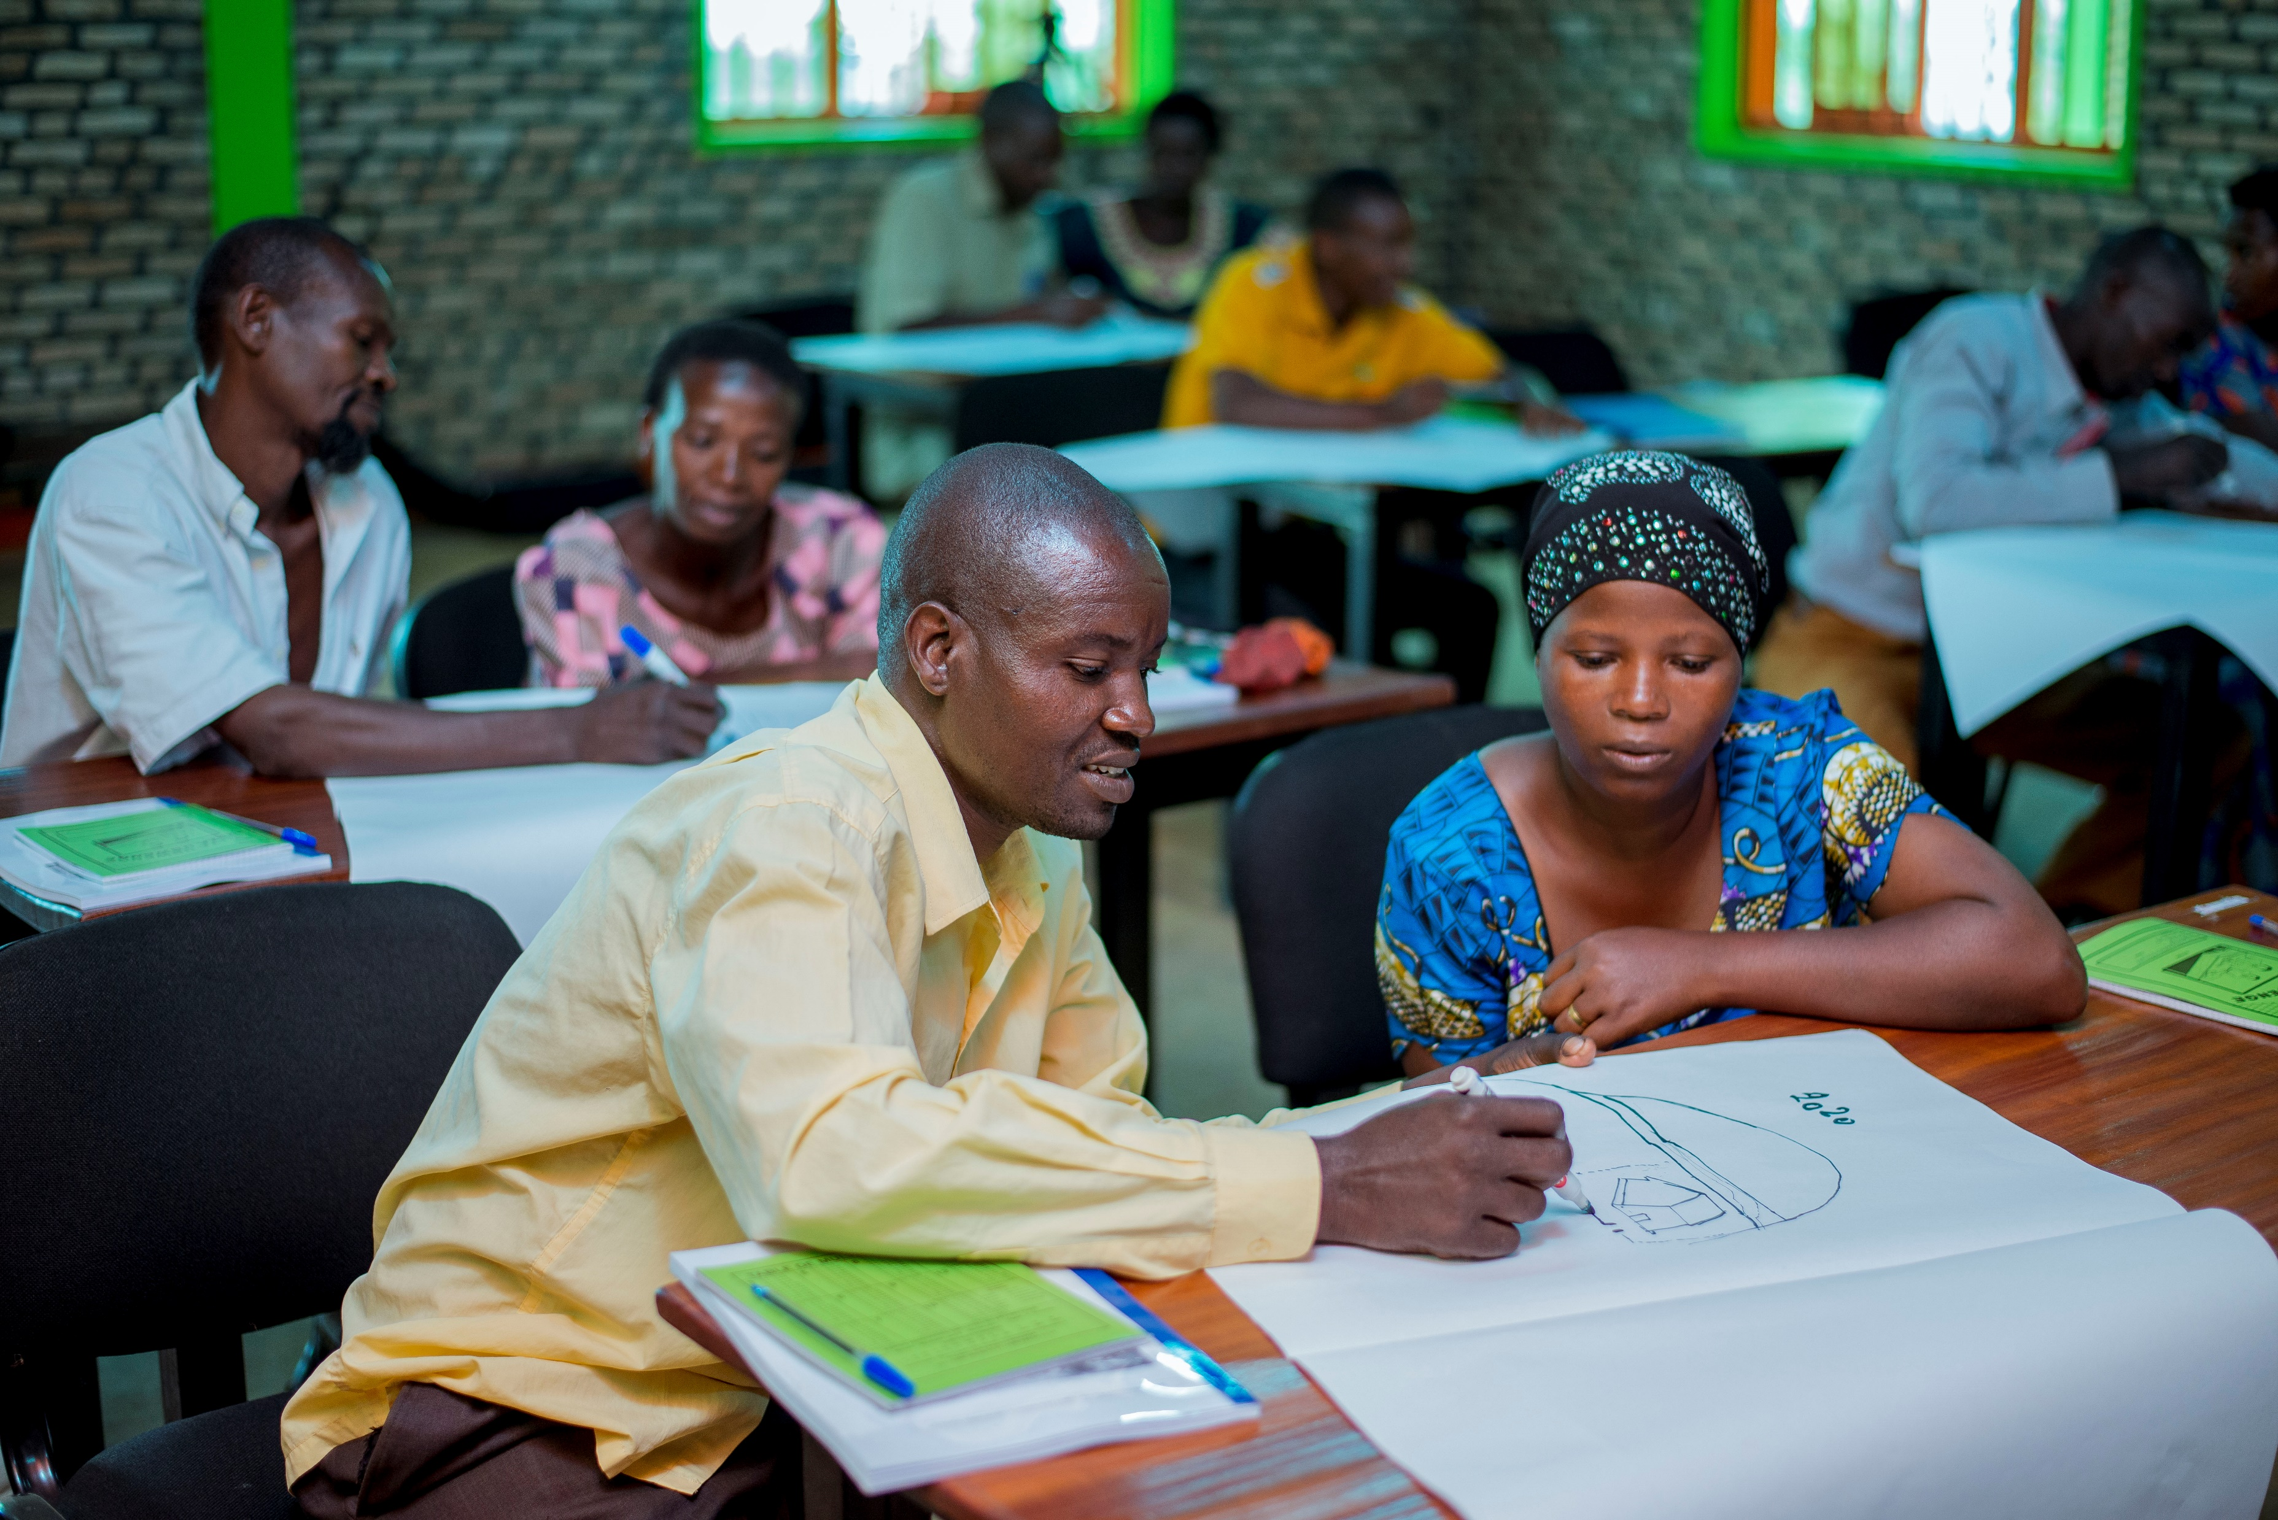
26. | VCA
Assessing Vulnerability and Capacity
Determine capacities and vulnerabilities present in your area
Here focus lies on community based assessment in project
Both might vary for different social groups
Assess for different hazards and social groups
Notes:
Vulnerability and capacity might be different for different social groups. Assess for different hazards and different social groups.

Slide 31
27. | VCA
Assessing Vulnerability and Capacity
In assessing
Use community groups
Apply participatory tools and question sets
Use hazards identified in Hazard Assessment
Start by asking for the impact of hazards
Look at all 5 categories
Make use of secondary data and key informant to complement community input
Notes:
Now it turns practical. Important steps and suggestions for participatory assessment of community vulnerabilities and capacities
Community groups: (youth) SHGs, Parenting groups, farmers groups, church groups, Child rights clubs, extra meeting…
Tools and questions sets will follow in the next slides. Can also be found in the PRA Toolbox and document VCA Questionnaires.

Slide 32
28. | VCA
Assessment: VCA Tool
New PRA Tool: “Vulnerability and Capacity Assessment”
Looks at Vulnerabilities and Capacities for different groups
General question set to assess Vs and Cs
Additional questions to ask if community struggles with natural hazards
If Vs and Cs are assessed in relation to a specific hazard, make sure to assess the impact of the hazard. (first question of the hazard specific ones)
NEW Vulnerability and Capacity Assessment tool
Notes:
Show VCA tool Set a hazard/disaster for which you are assessing Vulnerabilities ad Capacities.
This is the main structure for the assessment
‘Main impact’ answers the damage the hazard does to this category of assets
If answer to a question indicates a weakness it is taken down as a vulnerability
If answer to a question indicates a strength it is noted as a capacity
Question overview for all hazards follow below. More questions can be added.

Slide 33
Which people in the community are most vulnerable? Why are they most vulnerable?
Which people in the community are least vulnerable? Why are they least vulnerable?
Which health problems persists in the community that reduce people’s ability to earn a livelihood, care for children, be part of the community or cope with disaster? In which months are these health problems most serious?
What skills, knowledge and educational levels exist in the community?
If hazards are present in the community:
What impact does the main hazard have on human life and health in the community? For example, death, injury, hunger, reduced ability to work.
Which people in the community are most affected by the hazard? Why are they most affected?
Which people in the community are least affected by the hazard? Why are they least affected?
Have you received any information or training about how to cope with disasters? Where did this information come from?
What skills and knowledge help people cope better with disasters? For example, ability to swim; knowledge of wild foods; boat-handling skills?
41. | VCA
Assessment Questions “Individual” Category
Notes:
Questions to ask for assessing the “individual” category. As found in the VCA Tool. Note answers to the questions as vulnerabilities or capacities.
“If hazards are present in the community”
Questions to ask in relation to a specific hazard the community struggles with.

Slide 34
Which groups exist in the community? (Venn diagram can help)
Which family links or relatives do people depend on most?
Who provides leadership? For example, traditional leader; government officials; religious leader; others.
What government services exist in the community?
If hazards are present in the community:
How does the main hazard affect social life? For example, more/fewer ceremonies; school attendance drops; migration; more crime or disputes etc.
Which community groups is most helpful in times of disaster? Please give reasons.
Which family links or relatives are most helpful to you during times of disaster?
Are there people in the community who benefit from disaster? If yes, please give details of why and how.
Who provides leadership and good guidance in times of crisis? For example, traditional leader; government officials; religious leader; others.
What government services still function during disasters, and how do they help the community?
42. | VCA
Assessment Questions “Social” Category
Notes:
Questions to ask for assessing the “isocial” category. As found in the VCA Tool. Note answers to the questions as vulnerabilities or capacities.
“If hazards are present in the community”
Questions to ask in relation to a specific hazard the community struggles with.

Slide 35
Which natural resources are present, and which are sparse or missing in the community?
Is there restricted access to any natural resource (e.g., water or wood)? Which resources, and why is access restricted?
Is there competition or argument over any natural resource (e.g., wild food or banana trees)? Please give details.
If hazards are present in the community:
How does the main hazard affect natural resources? For example, impact on drinking water, grazing land, forest, fish, soil, etc.
Which natural resources (e.g., water, grass, trees, fish) are most affected by the hazard? Why does this damage occur?
Which natural resources are less affected by the hazards? Why are these resources not damaged or lost?
Is there restricted access to any natural resource (e.g., water or wood) during a disaster? Which resources, and why is access restricted?
Is there competition or argument over any natural resource during times of crisis? Please give details.
Which natural resources (e.g., wild food or banana trees) become especially important during disasters? Why is this?
43. | VCA
Assessment Questions “Natural” Category
Notes:
Questions to ask for assessing the “natural” category. As found in the VCA Tool. Note answers to the questions as vulnerabilities or capacities.
“If hazards are present in the community”
Questions to ask in relation to a specific hazard the community struggles with.

Slide 36
What structures and buildings exist in the community? Refer back to community mapping done in Step 2: exploring the community.
Which important structures and buildings are missing?
What communications systems are available in the community?
What means of transport are available and still useable during times of emergency? For example, boats, bicycles, other vehicles.
What tools, equipment, other physical assets to people in the community possess?
If hazards are present in the community:
How does the main hazard affect constructed features (e.g. houses, roads, bridges, school, wells etc)? What impact is seen on tools or other physical belongings
Which buildings or structures are most affected by the hazard?
Why does this damage occur?
What communication systems are available during times of crisis? For example, mobile phones or radios.
How do people preserve their tools and household possessions during the crisis caused by the hazard?
What means of transport are available and still useable during times of emergency? For example, boats, bicycles, other vehicles.
44. | VCA
Assessment Questions “Physical” Category
Notes:
Questions to ask for assessing the “physical” category. As found in the VCA Tool. Note answers to the questions as vulnerabilities or capacities.
“If hazards are present in the community”
Questions to ask in relation to a specific hazard the community struggles with.

Slide 37
Which livelihoods (or income-generating activities) are present in the community?
What crops are prevalent and grow well?
Which financial assets to people have? For example, cattle, savings, remittances, sellable goods.
If hazards are present in the community:
How does the main hazard affect economic activities, such as farming, fishing, factories, or operation of local markets?
Which livelihoods (or income-generating activities) are most affected by the hazard?
Which livelihoods (or income-generating activities) are not affected or less affected by the hazard?
What new ways of generating income are used in times of crisis?
Which crops are most affected by the hazard? Why does this happen?
Which crops are less affected by the hazard? Why are they not so much affected?
How do people get money to buy food or other items during disaster? For example, from savings, remittances, selling, assets.
How is paid labour affected by the hazard?
45. | VCA
Assessment Questions “Economic” Category
Notes:
Questions to ask for assessing the “economic” category. As found in the VCA Tool. Note answers to the questions as vulnerabilities or capacities.
“If hazards are present in the community”
Questions to ask in relation to a specific hazard the community struggles with.

Slide 38
46. | VCA
Summarizing Information
Column 1 | Column 2 | Column 3 | Column 4 | Column 5
Category | Impact of hazards | Vulnerabilities | Capacities | Suggested risk-reducing activities
Individual
Social
Natural
Physical
Economic
Notes:
Suggested risk-reducing activities is linked to CBDRM Coaching session.
Normally completed in the office. E.g., done on a flipchart
Answers for columns 2,3,4 are taken from the questionnaires.
Different groups in the categories (e.g., male and female) may be captured by extra rows or by using different colours.
Try to put extra focus on children’s vulnerabilities and capacities.
Complement with key informant information
VCA identifies capacities and vulnerabilities at one point in time. They change over time.

Slide 39
47. | VCA
Column 1 | Column 2 | Column 3 | Column 4 | Column 5
Category | Impact of hazards | Vulnerabilities | Capacities | Suggested risk-reducing activities
Individual | Small loss of life; increased health issues | No warning system; lack of health knowledge | Able-bodied youth; carpenters | Train youth as volunteers to raise alarms and assist evacuation
Social | Families split up; disruption of education | No evacuation plan; location of school; shortage of social groups; poor government services | Health works in the community; government agricultural department; farmers’ cooperative | Community evacuation plan; women’s groups; strengthen cooperative; advocacy to improve and use government agricultural service
Natural | Destruction of smaller trees; deposition of sand on land | No protective embankment; erosion from upstream as result of tree felling | Bamboo and a few trees; forestry department nursery; available high land | Use bamboo to strengthen river bank; tree planting along bank and on slopes; advocacy to reduce tree cutting
Physical | Damage to houses, roads and bridges | Houses close to river; design of houses not strong | Some stronger houses; church building on higher land | Build stronger embankment; teach carpenters better house design; use church as evacuation centre in floods
Economic | Damage to crops; death of livestock | Fields near river; no embankment; growing season is during flood season; crop varieties not resistant; no warnings or evacuation plan for animals | Winter vegetable seed available; a few small livestock and chickens kept | Increase cultivation of winter vegetables; seek flood-resistant crops; evacuation plan to save cattle; expand alternative livelihoods (e.g., egg production
Summary Example
Notes:
→ You can let participants identify their own capacities and vulnerabilities here.
Each category can be split up into secondary groups e.g. social → women and men
Aim is to eventually build capacity where it is missing and reduce existing vulnerability.
How to create a suitable risk reduction action plan as part of the wider community action plan is covered in more detailed in coaching session Community-level risk management planning.

Slide 40
48. | Exercise
6. Roleplay exercise
20 minutes
Identify Vulnerabilities and Capacities in the community.
Notes:
Exercise: Analyse Vs and Cs in a fictional village. Break the group up in smaller groups. Online: Use Break-out-rooms in MS Teams. Send document with village and character descriptions to each group. Found in “VCA Roleplay” folder. Depending on how many participants and groups you have, give each group different characters or different number of characters. Together they should try to find vulnerabilities and capacities of the fictitious community. They can also be imaginative and come up with items not listed in their role description if it fits the context. It might be a good idea to assign each group a specific category of vulnerability and capacity to assess, otherwise it might be a bit to much. Also provide the document “VCA Tool” for the question sets. You assign how much time and freedom the groups have to do it.

Slide 41
49. | VCA
Summary VCA
Identify vulnerabilities and capacities (in relation to a specific hazard)
Look at different groups (women, men, different age)
Look at different assets
VCA can be used to track changes over time and disaggregate data by gender, age, wealth groups etc.
Notes:
Tools and their explanation can be found in PRA Toolkit.
The best way to due it, depends on the local context.

Slide 42
7. VCA in CCCD
50. | VCA & CCCD
Notes:
→ Ask participants how Vulnerability and Capacity Assessment can be used in, help, and contribute to CCCD. Let them give ideas and discuss together.
May be used during Needs Assessment stage
May be used during community challenge
Helps identify strengths and weaknesses present in the community
Helps understand threats and obstacle to children’s well-being and future.
Other ideas?

Slide 43
51. | VCA & CCCD
Preparation Phase
PROJECT DESIGN
Phase 2: Preparation Analyse disaster risk on country, area, and sector level. Collect general vulnerabilities and capacities on broader context.
Activities: | Knowledge outcomes:
Collect basic information on vulnerabilities and capacities in the project area. Use secondary data and government statistics. Determine general vulnerability levels | General awareness of vulnerabilities and capacities in project area Understanding of information gaps and needs
Notes:
For context analysis. Only broad. Using secondary data. Not yet with community. Most of this is already part of the basic needs assessment.

Slide 44
52. | VCA & CCCD
Community Challenge
PROJECT PREPERATION (2PHASES)
Phase 3: Community Challenge Assess local community capacities and vulnerabilities.
Activities: | Knowledge outcomes:
Participatory Vulnerability and Capacity Assessment using different PRA tools Creation of Community Venn diagram | Identification of vulnerable locations within community: settlements, production facilities, critical facilities Determination of expected damage to people, property, livelihoods, and disruption to implementation plans Identification of vulnerable assets and elements at risk within the community
Notes:
Most important time for VCA during community challenge.
This is the phase where you use the table and VCA question sests.

Slide 45
53. | VCA & CCCD
Implementing Phase
PROJECT DESIGN (4PHASES)
Phase 4 – Phase 9 Focus on monitoring progress
Activities: | Knowledge outcomes:
Ongoing monitoring of community vulnerabilities and capacities | Identification of changing vulnerabilities and capacities Determination of improved resilience or increased vulnerability
Notes:
In implementation phase it has a monitoring role to see whether anything is changing. As mentioned above, VCA can be used to track changes over time.

Slide 46
54. | VCA & CCCD
Integrating VCA in CCCD structures
Which existing CCCD structures can be used to facilitate VCA?
Notes:
Either have participants speak up, write ideas into the chat or discuss in breakout groups.
The VCA can be built into already existing CCCD structures. E.g.
(Youth) SHGs
Parenting classes
Needs assessment

Slide 47
55. | VCA & CCCD
Capacity building in CCCD
Social: SHGs, community networks
Financial: credit schemes, increase of labour opportunities
Individual: knowledge transfer, skills training, agricultural training
Others?
Notes:
VCA helps to identify what issues the community faces and what may be done about them. It identifies which vulnerabilities need to be addressed and which capacities need to be build.
Capacity building is already part of CCCD. Ask trainees how CCCD contributes to building capacities at the moment.
CCCD programming already address vulnerabilities and builds capacities.
Others?
Knowing vulnerabilities and capacities help build resilience and knowing where to focus programming.

Slide 48
Short Quiz
56. | Quiz
Notes:
A short quiz about the content of this session can be found under https://www.onlinequizcreator.com/vulnerability-and-capacity-assessemnt/quiz-478242
Share the link with the participants in the cha function.
Tell participants to click at the beginning on “view my result without an account” under “Start without an account”.

Slide 49
Start without an account
57. | Quiz
Go to https://www.onlinequizcreator.com/vulnerability-and-capacity-assessemnt/quiz-478242 and do the short quiz of 11 questions
Notes:
A short quiz about the content of this session can be found under
https://www.onlinequizcreator.com/vulnerability-and-capacity-assessemnt/quiz-478242
Share the link with the participants in the chat function.
Tell participants to click at the beginning on “view my result without an account” under “Start without an account”.

Slide 50
58. | Questions
Are there any questions?
Notes:
Ask for some feedback, send email if you have any feedback.
Photo credits: Help a Child

Slide 51
59. | End
Thank you for attending
Notes:
--> Can be added to the slide ‘If you have any questions, please email ….. ‘

Slide 52
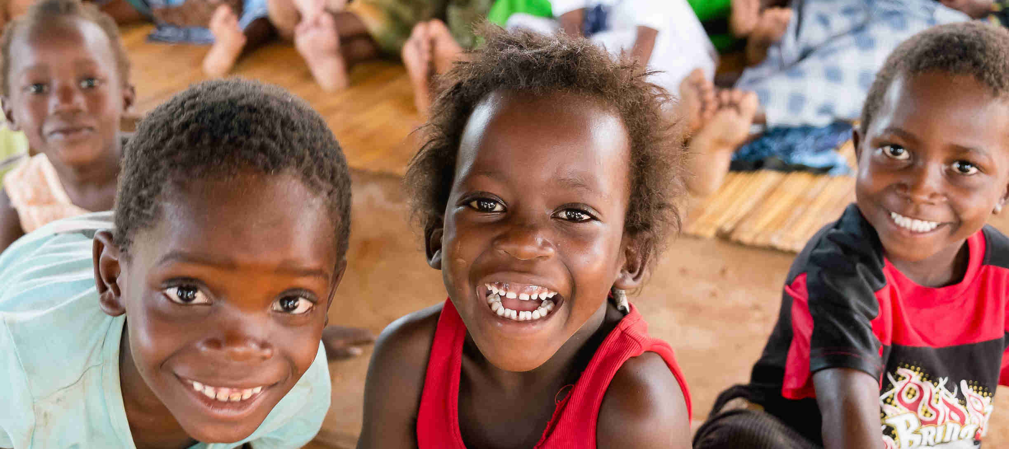
COFFEE/TEA BREAK
10 mins
Notes:
Use this slide when a break is needed during the coaching session/ppt presentation.
Image credit: Peter van der Lingen, Fine Art Weddings, www.petervanderlingen.nl

