Slide 1
1. | Welcome
Introductory Coaching Session
November 2021
Notes:
Introduce title, yourself as trainer and go over to the next slide (table of contents) to take trainees through what will be discussed.
Whenever a sentence in the notes section is bold and has an arrow (→) at the beginning then it’s an activity that can be done with the trainees (e.g. → activity )
Image credit: Peter van der Lingen, Fine Art Weddings, www.petervanderlingen.nl

Slide 2
House rules
2. | House Rules
Raise your hand if you have a question
Keep your microphone turned off
Keep your camera on
Notes:
These are some simple guidelines to give a small structure to the session.​
If someone raises their hand make sure you call on that person shortly, at a suitable moment, so that he/she can ask a question or give a comment. ​
If the coaching session is given in person, ask participants to raise their hand if they have a question and listen when another participant/facilitator is speaking. ​
Ask participants to keep their mic turned off while not speaking and only turn it on when they say something, e.g. after you have called on them for raising their hand. This keeps noise levels and distractions down.​
If participants have an instable internet connection, they can keep their camera off.

Slide 3
3. | Table of Contents
Table of Contents
Learning Objectives
What is Disaster Risk Reduction?
Key Definitions
The Disaster Management Cycle
Community Based Disaster Risk Reduction (CBDRM)
Activity
Notes:
Image credits: Red een Kind

Slide 4
4.| Learning Objectives
Learning Objectives
At the end of this session, you are able to:
Understand and explain different definitions related to DRR.
Understand and explain the different stages of the Disaster Management Cycle.
Understand CBDRM and explain the different phases.
Identify different assessments and participatory tools linked to CBDRM.

Slide 5
Are there any questions?
Notes:
→ Use this slide after the different sections in the presentation and at the end of the presentation
Photo credits: red een kind

Slide 6
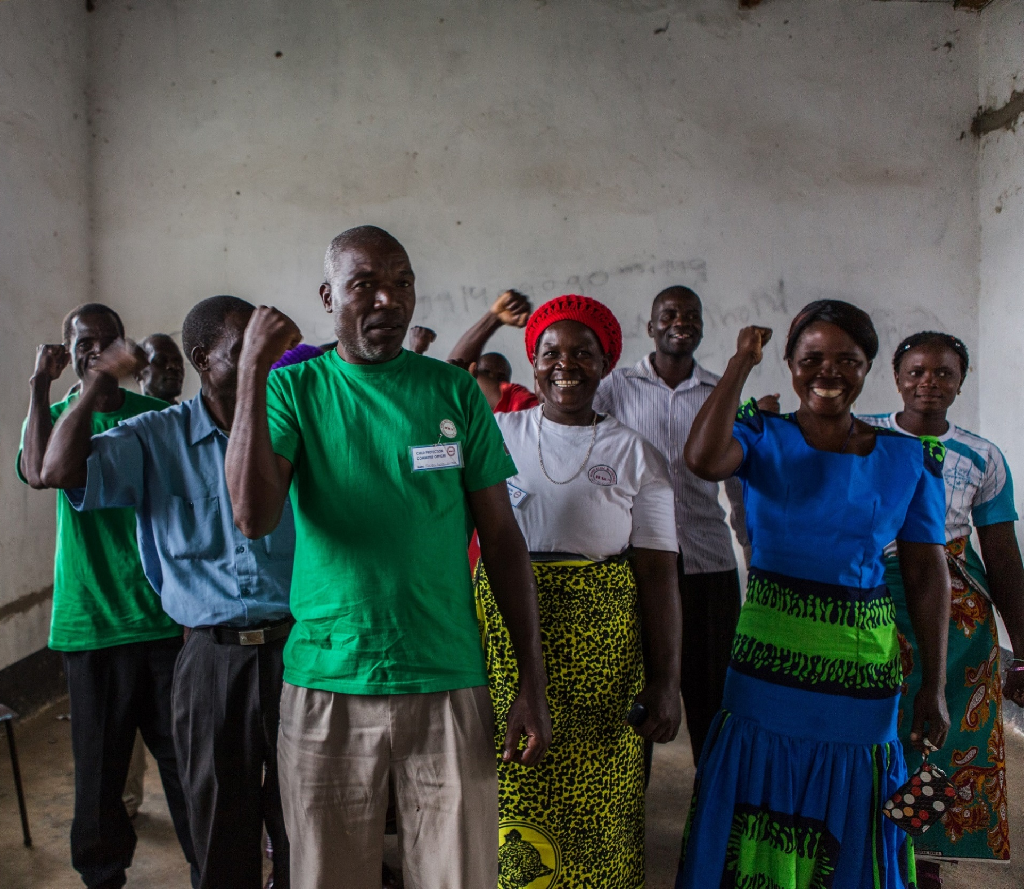
What is Disaster Risk Reduction?
5. | What is DRR?
Notes:
→ Ask the trainees whether they know what DRR is before showing them the definition (ask to answer in the chat).
Image Credits: Red een Kind

Slide 7
6. | What Is DRR?
What is DRR?
Reducing risk through analysing hazards and disasters present in an area.
Reducing vulnerability and exposure of people, assets, or systems.
Improving preparedness of people, assets, or systems for a hazard or disaster.
Using the capacities and strengths of a community to minimize the impact of a hazard turning into a disaster.
Notes:
Explain that DRR consists of different elements (analysing hazards & disasters, vulnerability, exposure, and the involvement of the community).
The concepts mentioned above will be explained in the next slides.

Slide 8
7. | DRR and Child Protection
Why is DRR important for Help a Child?
For the well-being and protection of children who live in hazard-prone areas.
To raise awareness on the impacts of a disaster and how children can best react if a disaster were to occur.
The DRR approach, CBDRM, highlights how essential it is to include all community members including children.
Notes:
Image credit: Red een Kind

Slide 9
8. | Key Definitions
Disaster Risk Reduction
Hazard
Capacity
Risk
Resilience
Vulnerability
Exposure
Key Definitions
The concepts listed on the left are important and closely linked/related to DRR.
The next couple of slides will explain the definitions of each concept.
Notes:
Mention the different concepts and recap that each concept is related to DRR and plays an important role in child protection.

Slide 10
9. | Disaster
Disaster?
Impact of natural or man- made phenomena
on a vulnerable population
causing disruption, damage, and causalities.
What is a disaster? A disaster is the sudden or unexpected occurrence of an event that causes human suffering, disruption or damage to a vulnerable population.
The definition can be seen as three separate elements (CRED, 2012):
Notes:
Ask the trainees whether they can give examples of disasters (own country context) (turn on their mic or in the chat or in person by raising their hand).
Disasters always impact people (loss of live, casualties or causes human suffering).
Natural or man-made phenomena can be defined as a hazard (explained in next slide).
Potentially use ppt. slides to show images and ask which of these are disasters.

Slide 11
10. | Hazard
Hazard?
What is hazard? A hazard is a threat - A natural or man-made event that has the potential to cause injury to life, damage to property, livelihood, environment, and can potentially trigger a disaster.
There are two types of classification for hazards:
Man-made
Natural

Slide 12
11. | Hazard
Hazard?
Man-made
Conflict and civil unrest
Natural
Earth related
Weather related
Climate related
Industrial accidents
Transport accidents
Other accidents
Biological
Notes:
Ask trainees how many different types of hazards they see in their country context (answer in chat/turn mic off or in person by raising hands).

Slide 13
12. | Vulnerability
Vulnerability
What is Vulnerability? Vulnerability is being exposed to the negative impacts of a hazard (which can turn into a disaster) due to location or being prone/susceptible to damage or injury. Vulnerability is often related to economic poverty, social isolation, and political marginalization.
Vulnerability can be split up into five aspects.
Notes:
When different independent processes interact, unsafe conditions can also create vulnerability.

Slide 14
13. | Vulnerability
Vulnerability
Individual
Knowledge, health status, skills of individuals
Social
Natural
Economic
Ability to buy and sell, livelihoods and income generation
Physical
Cohesion and relations within the community
Resources in and around the community e.g. livestock, trees, crops
Infrastructure and construction e.g. roads, buildings, hand-pumps
Notes:
Take trainees through the different types of vulnerability, explaining what each type entails.

Slide 15
14. | Capacity
Capacity?
What is capacity? Capacity are the strengths, coping strategies, and resources that exist within the people and their communities. These can be used to mitigate, prepare for, and cope with damaging effects of disaster, or quickly recover from a disaster. For example; resources, knowledge skills, and social safety nets.
→ The absence of capacity leads to vulnerability and vice versa.
Notes:
In comparison to vulnerability, capacity can also be analyzed using the five different aspects (individual, social, natural, physical, and economic).

Slide 16
15. | Risk
Risk?
A hazard occurring
which impacts vulnerable people, assets and systems
but can be minimized by the capacity of vulnerable people to respond to the disaster.
What is Risk? Risk is the probability of an outcome having a negative impact on people, assets and systems (UNDRR, 2021).
Disaster risk is a result of three elements:
Notes:
Definition Risk from UNDRR: https://www.undrr.org/terminology/disaster-risk

Slide 17
16. | Risk
Risk?
The disaster risk formula is essential to understand which elements contribute to disaster risk. As well as see how hazard, vulnerability and capacity are linked to each other and can either increase or decrease disaster risk of a community.
$$Disaster Risk=\frac{Hazard x Vulnerability}{Capacity}$$
Notes:
Explain the Disaster Risk Formula and how hazard and vulnerability cause a higher disaster risk while capacity combats disaster risk.
Disaster Risk is a result of a hazard impacting a vulnerable population. Capacity can minimize disaster risk because it makes a population less vulnerable (further explained later).

Slide 18
17. | Resilience
Resilience
What is Resilience? Resilience (in the context of disaster risk) is the ability of people, assets or systems exposed to hazards to resist, absorb, accommodate, adapt to, transform and recover from the effects of a hazard in a timely and efficient manner (UNDRR, 2021).
Notes:
Definition from UNDRR: https://www.undrr.org/terminology/resilience

Slide 19
18. | Exposure
Exposure
What is Exposure? Exposure occurs when people, infrastructure, assets, or systems are located in hazard-prone areas. If people were not living in hazard-prone areas then there would be no exposure to risk.
The extent to which people are exposed depends on the type of hazard and level of vulnerability.
Notes:
Give example: A family is living in a hazard-prone area but has built a strong and protective house, then the family is less exposed than a family who is living in a poorly constructed home.

Slide 20
19. | Activity
Activity
The following video looks at a community in the Philippines that is working towards becoming more prepared and resilient in a disaster-prone area.
Can you identify the answers to the questions below based on the information in the video?
Can you identify different types of hazards faced by the community?
What types of vulnerabilities and capacities do the community have?
Does the community have a Disaster Reduction Plan?
Does this make the community more Resilient?
Notes:
→ Split trainees into breakout rooms or plenary (if the group is small). Give them time to discuss and then come back together to discuss thoughts.

Slide 21
20. | Activity
https://youtu.be/DDZNm4KQE9o
Notes:
Embed video link in ppt (so that participants can see the video in the ppt instead of having to switch between the ppt and YouTube browser).
After you’ve shown the video, go back to the questions and ask participants what they think the answers are. If the group is big, then breakout rooms can be used.

Slide 22
Are there any questions?
Notes:
→ Use this slide after the different sections in the presentation and at the end of the presentation
Photo credits: red een kind

Slide 23
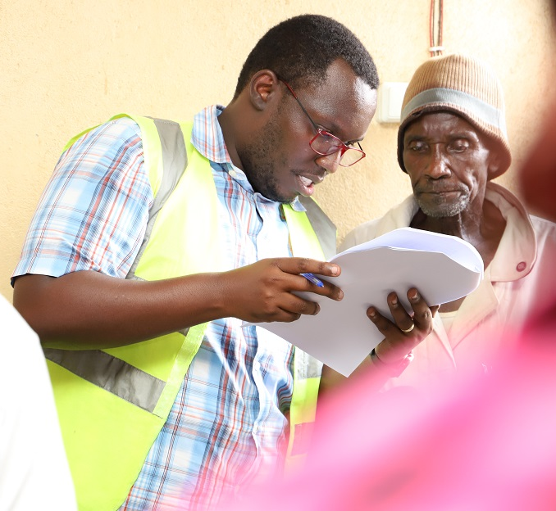
The Disaster Management Cycle
21. | The DM Cycle
Notes:
→ Ask the trainees whether they know what DM cycle is before showing them the definition (ask to answer in the chat/turn mic off or raise hand and answer in person).
Image Credits: Red een Kind

Slide 24
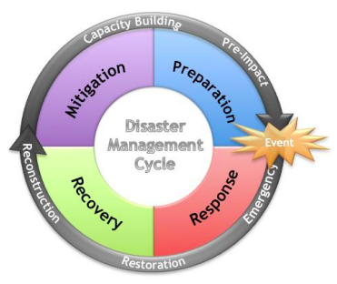
22. | The DM Cycle
The Disaster Management Cycle
What is the Disaster Management Cycle? The Disaster Management (DM) cycle looks either reducing/avoiding losses or the negative impact of a disaster on a community. The DM cycle looks at four different phases that communities, governments, institutions, societies, and countries can use to prepare, mitigate, recover and respond to a disaster.
Four elements of the Disaster Management Cycle are:
Notes:
In between the phases ‘preparation’ and ‘response’, a disaster/event occurs.
The cycle aims to reduce risk of: - Systems (e.g. governmental relations) - Assets (e.g. infrastructure, crops, livestock) - People (e.g. individual or community)
The next slides will look at each phase.
Image credit: Federal Emergency Management Agency from article written by Aydın, Can & Tecim, Vahap. (2015). DESCRIPTION LOGIC BASED EARTHQUAKE DAMAGE ESTIMATION FOR DISASTER MANAGEMENT. Anadolu University Journal of Science and Technology-A Applied Sciences and Engineering. 15. 93. 10.18038/btd-a.01308.

Slide 25
23. | Mitigation
Mitigation
What is Mitigation? Minimizing and avoiding the negative impacts of a disaster to avoid damage or loss to assets, systems, or people. Examples of Mitigation strategies: Building codes and zoning, vulnerability and capacity assessment, public education, policy study, and advocacy.
Notes:
Mitigation reduces the vulnerabilities and exposure of people to a disaster but also enhances the capacities of the affected community.
Image credit: https://www.researchgate.net/publication/277821446_Public_education_and_public_awareness_for_disaster_risk_reduction_Key_Messages

Slide 26
24. | Preparedness
Preparedness?
What is Preparedness? Strengthening the capacities of affected communities to cope with the impact of future disasters. Examples of Preparation: Preparedness plans, emergency exercises/training, early warning systems, community risk assessment, strengthening the organization, and inter-agency arrangements.
Notes:
Through pre-disaster activities, the community is prepared and ready to react if a disaster were to occur.
The aim of the preparation phase is that if a disaster were to strike, the disaster risk of the community is minimized due to proper preparedness and knowledge.
Image credit: https://devpolicy.org/reducing-disaster-risk-understanding-barriers-womens-leadership-20170704/

Slide 27
25. | Response
Response
What is Response? Immediate aid and assistance to save lives and provide people with food, shelter, and medical assistance. Examples of response: Provide medical/food/shelter/basic necessity assistance, emergency relief giving, emergency operations centre, search and rescue, repair critical facilities and services.
Notes:
This phase is crucial for saving lives and providing immediate help. Image credit: https://www.istockphoto.com/nl/fotos/disaster-relief

Slide 28
26. | Recovery
Recovery
What is Recovery? Focusing on rebuilding or fixing what was damaged by a disaster. An important concept related to recovery is 'Building Back Better' (BBB). Examples of recovery: Creating alternative livelihood programs, resettlement & rehousing and cash assistance programs
Notes:
After a disaster the community will need to recover. Take time to explain this concept (BBB): Where external or internal assistance helps a community recover from a disaster by having a positive impact and not a negative one. By providing new infrastructure for example, which in the long term benefits the community.
Image credit: https://www.nrc.no/what-we-do/themes-in-the-field/cash-and-vouchers/

Slide 29
27. | Activity
Activity
Mitigation | Preparedness | Response | Recovery
Match each concept to the right definition provided.
You will be given 5-10 mins to complete the task.
When we come back we will choose different breakout groups to explain which definition goes with which concept.
Setting up an Early Warning System that informs the community of an upcoming disaster via text.
Rebuilding schools and the town hall in a community that was destroyed by a tsunami.
Integrating knowledge on different types of disasters and their impact into a communities schooling curriculum.
Providing a community with food, medical help, and shelter.
Notes:
Split trainees into breakout groups (split evenly) and ask each group to match the concept to the right definition (each DM cycle phase) on whiteboard or padlet.
The concept and definitions will be sent to each breakout room.
When we go through the answers (each breakout room one concept and definition) ask trainees whether they agree or not (thumbs up or thumbs down).
If done in person, split trainees into even groups and provide each group with a pair of scissors and the concepts and definitions (can also already be cut up before coaching session). After 20 mins, everyone comes back together and answers will be discussed.
The correct answers are:
Mitigation - Integrating knowledge on different types of disasters and their impact into a communities schooling curriculum.
Preparedness - Setting up an Early Warning System that informs the community of an upcoming disaster via text.
Response - Providing a community with food, medical help, and shelter.
Recovery - Rebuilding schools and the town hall in a community that was destroyed by a tsunami.

Slide 30
Are there any questions?
Notes:
→ Use this slide after the different sections in the presentation and at the end of the presentation
Photo credits: red een kind

Slide 31
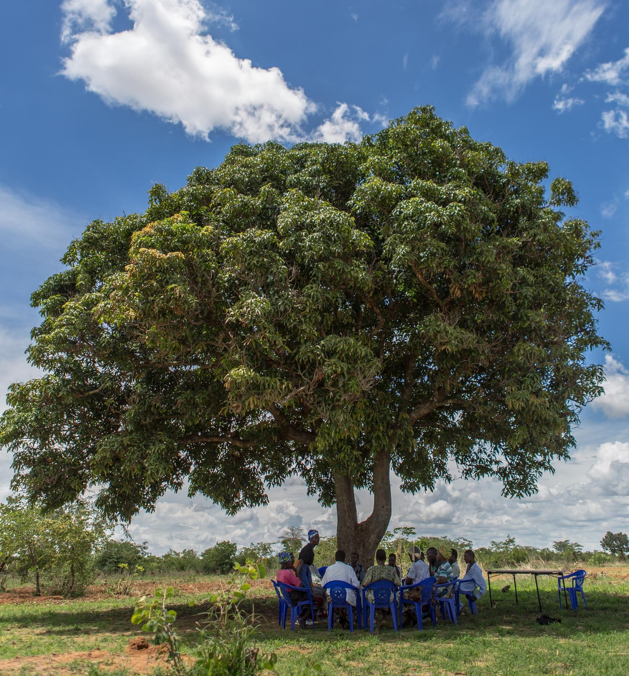
Community Based Disaster Risk Management (CBDRM)
28. | CBDRM
Notes:
Image Credits: Red een Kind

Slide 32
29. | CBDRM
What is CBDRM?
What is CBDRM? CBDRM takes a community through different phases to reduce existing risks. The local community are the centre point of CBDRM. CBDRM consists of 5 stages →
1. Preparation
4. Pressure and Release Model (PAR)
5. Community-level Risk Management Plan
2. Hazard Assessment
3. Vulnerability and Capacity Assessment (VCA)
Notes:
Ask the trainees whether they know what CBDRM is before showing them the definition (ask to answer in the chat).
!!! Let the participants know that individual coaching sessions have been created for each step of CBDRM (Hazard Assessment, VCA, PAR and Community-level Risk Management Plan) !!!
CBDRM is an important element of DRR. CBDRM is a bottom-up approach in contrast to a top-down approach. The community takes steps to manage disaster risk. By analysing and examining disasters, involving all community members and creating a disaster risk reduction strategy. Different tools and frameworks are used, depending on the CBDRM phase.
The models and frameworks related to each step will be explained in more detail in the following coaching sessions and practically put to use.

Slide 33
30. | CBDRM
Why is CBDRM important?
People in the community are involved and capacities are further developed.
Needs assessment is done by the community (no external or top-down approach interference).
Using the knowledge and capacities of the local community is important.
Participation of everyone (the vulnerable, elderly, children, women, and men).
All-encompassing approach including all DRR elements.

Slide 34
Participatory Tools
31. | Participatory Tools
Each step will also include participatory tools. Participatory tools can be used by the community for different purposes:
Identify hazards, risks, vulnerabilities, and capacities of the community.
Create an environment for discussions and the expression of opinions.
An effective method of implementing knowledge.
Promotes inclusiveness of all community members.
Each CBDRM step involves different participatory tools which allow for an effective method of collecting information, spreading new knowledge and including all community members.
Notes:
Let each participant know that the links to each participatory tools document will be shown the link at the end of the presentation.

Slide 35
32. | Preparation
1. Preparation
What is Preparation?
Training and equipping the facilitation team, who will be working together with the community.
Informing the team on knowledge related to the CBDRM process, the terminology, how best to explain concepts to the community, and how to introduce the different Participatory Appraisal tools which the community will be using.
The Preparation step has different Participatory tools: Community mapping, Target area mapping and Child development/well-being matrix.
Notes:
Participatory tools are tools that can be used by the community for different purposes (identify hazards, risk, vulnerabilities and to create an environment for discussions and knowledge implementation).

Slide 36
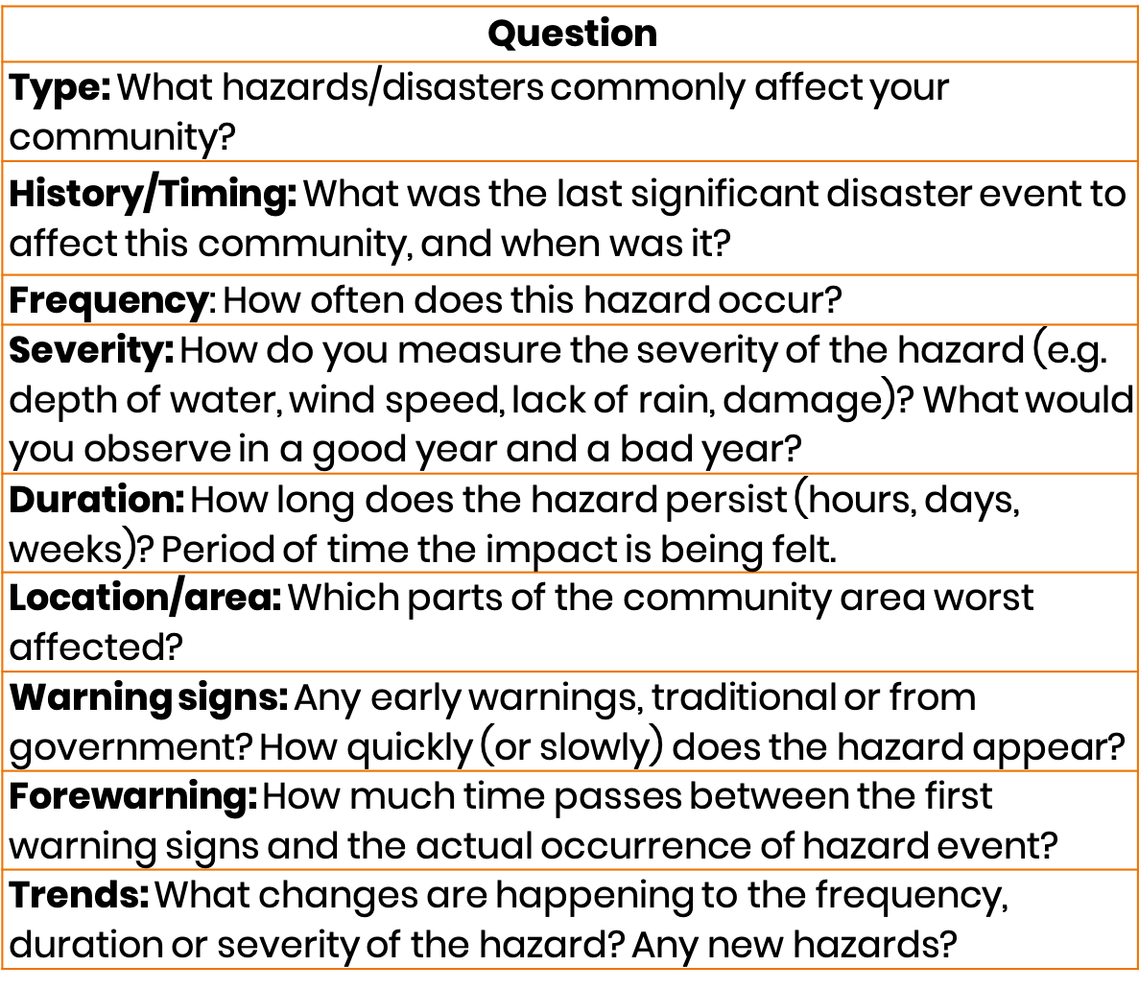
34. | Hazard Assessment
2. Hazard Assessment
What is a Hazard Assessment? Identifying and analyzing hazards that are seen in the community or in the area which have an effect on the communities well-being. After the community has identified the different types of hazards, follow-up steps can be to minimize the impact a hazard can have on the community.
Notes:
As mentioned before, there are different types of natural and man-made hazards.
→ Ask the trainees whether they can name different man-made and natural hazards.
Man-made
Conflict and civil unrest
Industrial accident
Transport accidents
Other accidents
Natural
Earth related
Weather related
Climate related
Biological
The Hazard identification assessment is pictured on the right.
Picture from Henrik and ROOTS document: https://learn.tearfund.org/-/media/learn/resources/series/roots/roots-9-reducing-risk-of-disaster.pdf

Slide 37
3. The Vulnerability and Capacity Assessment (VCA)
35. | The VCA
What is the VCA? The VCA contains different elements that provide a broad overview of different vulnerabilities and capacities in areas of an individual's life within a community.
The VCA is filled in with answers received through focus group discussions, interviews, or conversations with the community. Full participation of all community members is crucial for a successful and participatory analysis.
Notes:
Full participation is essential because community members will have different vulnerabilities and capacities, male and female members could be interviewed separately for example, or younger and older members.
The VCA focuses on the different aspects seen in the picture. Each aspect is analyzed separately to see what kind of impact a hazard has. For example, drought will have a bigger impact on the natural aspect (crops, livestock, access to water) but a smaller impact on the physical aspect (building infrastructures, roads).

Slide 38
4. The Pressure and Release Model (PAR)
36. | The PAR
What is the PAR Model?
A model which analyzes underlying risk factors to understand as to why a community is vulnerable and which hazards the community is faced with. To understand why the community is prone to facing disasters.
The equation Risk = Hazard x Vulnerability is essential for the PAR Model.
Vulnerability is analyzing collectively through looking at root causes, dynamic pressures and unsafe conditions. As well as look at hazards affecting a community.
Notes:
The following slide has a picture of the PAR Model

Slide 39
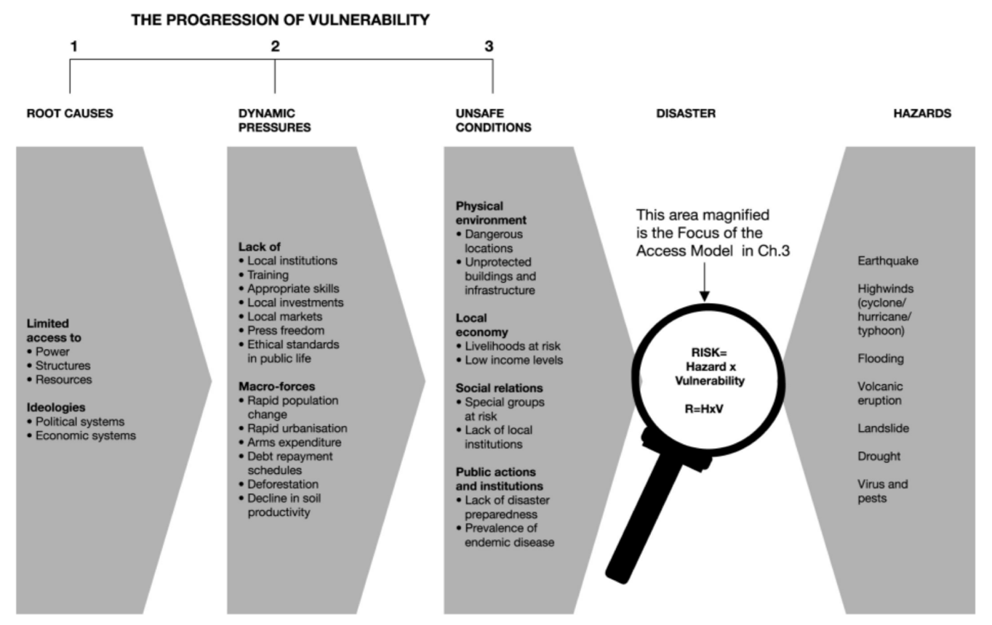
At Risk, Ben Wisner - https://www.preventionweb.net/files/670_72351.pdf

Slide 40
38. | Vulnerability
Progression of Vulnerability
What is Progression of Vulnerability? There are three stages of vulnerability. The stages Root Causes, Dynamic Pressures and Unsafe Conditions contribute to the increase or progression of vulnerability of a community/individual.

Slide 41
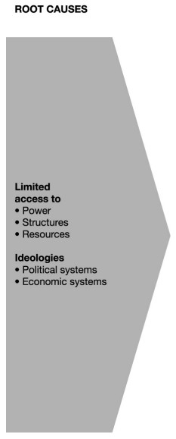
39. | Root causes
Root Causes
What are Root Causes? Root cause are the social, political and economic factors that contribute to vulnerability of hazards, leading to potential disasters and emergencies.
For example:
Do people have access to resources?
Do people have access to political power?
Is the economic/political system fair and inclusive of everyone?

Slide 42
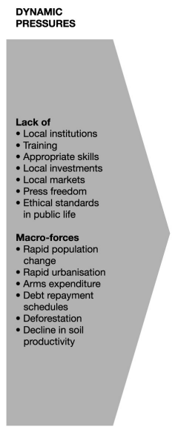
40. | Dynamic Pressures
Dynamic Pressures?
What are Dynamic Pressures? Dynamic pressures look at elements that are missing within a society/country or elements which exacerbate underlying root causes.
For example:
Are there local institutions? Local markets? Press freedom?
Are people given proper education and health opportunities?
Are people respected and ethically accepted in communities?
Which macro-forces are present in the area?
Notes:
Examples of dynamic pressures could be; disease, rapid urbanization, current wars, foreign debt. Dynamic pressures also identify what is missing in an area/community (‘lack of’).

Slide 43
41. | Unsafe Conditions
Unsafe Conditions
What are Unsafe Conditions? Unsafe conditions looks at the physical environment, local economy, social relations, public actions and institutions that increase vulnerability of a community to hazards. Underlying root causes and dynamic pressures contribute to the severity of unsafe conditions.
For example:
People who live in hazard-prone areas
Improper protection by the government
Unable to afford safe housing
Limited food to eat
Each element of the unsafe conditions section must be taken into consideration since each one is linked to the other (can be seen or unseen).
Notes:
Each element of the unsafe conditions section must be taken into consideration since each one is linked to the other (can be seen or unseen).

Slide 44
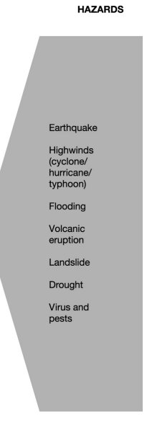
42. | Hazard
Hazard
What is hazard?
A hazard is a threat - A natural or man-made event that has the potential to cause injury to life, damage to property, livelihood, environment, and can potentially trigger a disaster.
→ Risk = Hazard x Vulnerability
There are two types of classification for hazards:
Man-made
Natural
Notes:
→ Ask trainees whether they know what a hazard is? (is recap from previous slides)

Slide 45
43. | Disaster
Disaster
What is a Disaster?
A disaster is the sudden or unexpected occurrence of an event that causes human suffering, disruption or damage to a vulnerable population.
For example:
Loss of lives
Destruction of infrastructure/physical environment
Notes:
→ Ask trainees whether they know what a disaster is? (is recap from previous slides)

Slide 46
6. Community-level Risk Management Plan
44. | Plan
What is a Community-level Risk Management Plan? This is a plan created by the community to finalize concrete steps and plans that will be taken to minimize risk.
This step can be considered the most important, requires the most time and attention. Again, both men and women and members of all ages must be included in creating a Risk Management Plan. Creating a Community-level Risk Management Plan includes 5 different steps.
Verifying data
Prioritizing impacts
Identifying risk-reducing activities
Evaluating suggested activities
Implementing activities
1.
2.
3.
4.
5.
Notes:
This stage is the most important and most time-consuming step of CBDRM.
Check that the community agrees that the vulnerabilities identified are associated with specific impacts, and that the listed capacities are indeed present in the community.
Allow the community to select the most important impacts from the list (or pictures) presented.
Collect suggestions for possible risk-reducing measures, including ideas from the facilitator, if the community have few ideas of their own.
Discuss these ideas, and decide which activities are the most likely to succeed.
Develop a risk management plan to implement the selected activities.

Slide 47
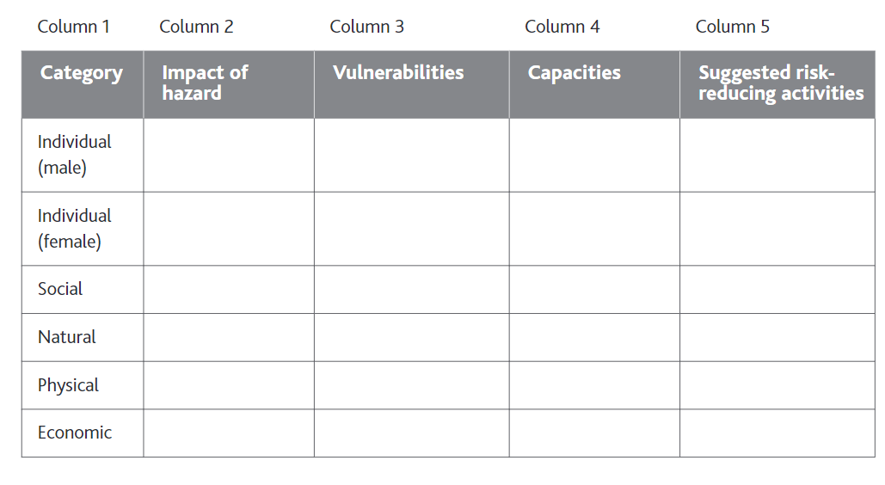
6. Community-level Risk Management Plan
45. | Plan
Step one – Verifying data
Ensuring that capacities are vulnerabilities identified are agreed upon by the community through collecting feedback.
Method of collecting feedback will be adjusted and decided upon depending on the community context.
Notes:
Potential set up for collecting feedback from the community to see whether vulnerabilities and capacities are agreed upon.

Slide 48
6. Community-level Risk Management Plan
46. | Plan
Step two – Prioritizing impact
The community is allowed to choose which impacts (from hazard) are most important.
Step 1 (verifying data) should highlight different impacts of hazard.
Afterwards, a ranking exercise can be used by the community to rank most serious impacts.

Slide 49
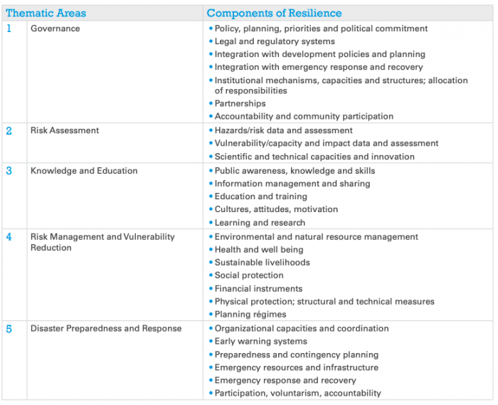
6. Community-level Risk Management Plan
47. | Plan
Step three – Identifying risk-reducing activities
The community is asked whether they have ideas on how to address the vulnerabilities faced by the community.
A potential framework that could be of benefit and used as guideline is the Twiggs resilience framework

Slide 50
6. Community-level Risk Management Plan
48. | Plan
Step four – Evaluating suggested activities
Discuss chosen ideas and see which are most feasible, effective, and efficient in reducing risk.
Discuss openly with the community whether the suggested activities are of benefit to the community, each individual and the surrounding environment.
Notes:
Find ways to minimize negative side-effects. If there are no ways to reduce or remove negative impacts, the activity should be rejected.

Slide 51
6. Community-level Risk Management Plan
49. | Plan
Step five – Implementing activities
Create a community-level risk management plan which includes chosen activities to reduce risk and other important aspects to take into consideration. Such as method of implementation, person responsible and to be done by which date.
The following table can be used as guideline and distributed among the community.
Notes:
Decide how activities will be carried out.
Template for this table is available in the ‘community-level risk management plan’ folder.

Slide 52
50. | Activity
Activity
Let’s play a Kahoot game!
Grab your phone or laptop, follow the link and type in the code provided on your device.
How many answers can you get correct?
https://create.kahoot.it/details/aba065ad-36e8-449c-961f-732a1764f547
Notes:
Ask trainees to grab their phones or laptop to join the kahoot game. Read out the code and wait till all trainees names come up on the screen.
If given in person: let each participant type in code on laptop or phone
If given online: share your screen as facilitator and show participants the code so that they can join on their phone or laptop.

Slide 53
51. | Thank you!
Thank you for listening!
Notes:
→ Can be added to the slide ‘If you have any questions, please email ….. ‘

